Slide 1


Amateur Extra Licensing Class
Components in Your New Rig
Presented by
W5YI
Arlington, Texas

Slide 2
Amateur Radio Extra Class
Element 4 Course Presentation
ELEMENT 4 Groupings
  Rules & Regs
  Skywaves & Contesting
  Outer Space Comms
  Visuals & Video Modes
  Digital Excitement with Computers & Radios
  Modulate Your Transmitters
  Amps & Power Supplies
  Receivers with Great Filters

Slide 3
Amateur Radio Extra Class
Element 4 Course Presentation
ELEMENT 4 Groupings
  Oscillate & Synthesize This!
  Circuits & Resonance for All!
  Components in Your New Rig
  Logically Speaking of Counters
  Optops & OpAmps Plus Solar
  Test Gear, Testing, Testing 1,2,3
  Antennas
  Feedlines & Safety

Slide 4
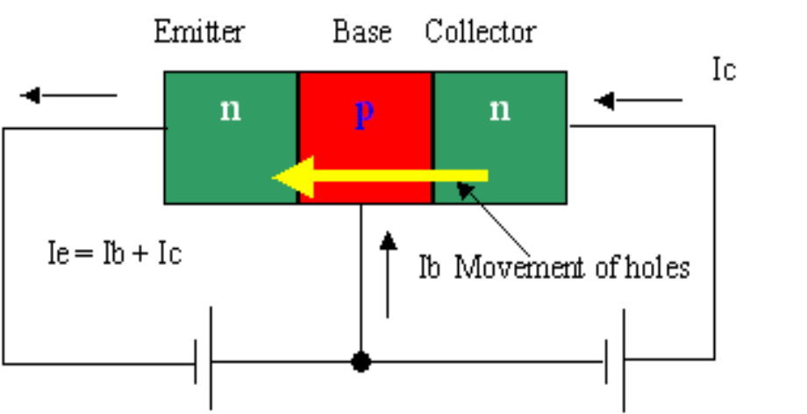
Amateur Radio Extra Class
Components in Your New Rig
E6A01… Free electrons are the majority charge carriers in N-type semiconductor material.
E6A02… N-type type of semiconductor material contains more free electrons than pure germanium or silicon crystals.
E6A03… Holes are the majority charge carriers in P-type semiconductor material.
E6D04… The name given to an impurity atom that adds holes to a semiconductor crystal structure is acceptor impurity.

Slide 5
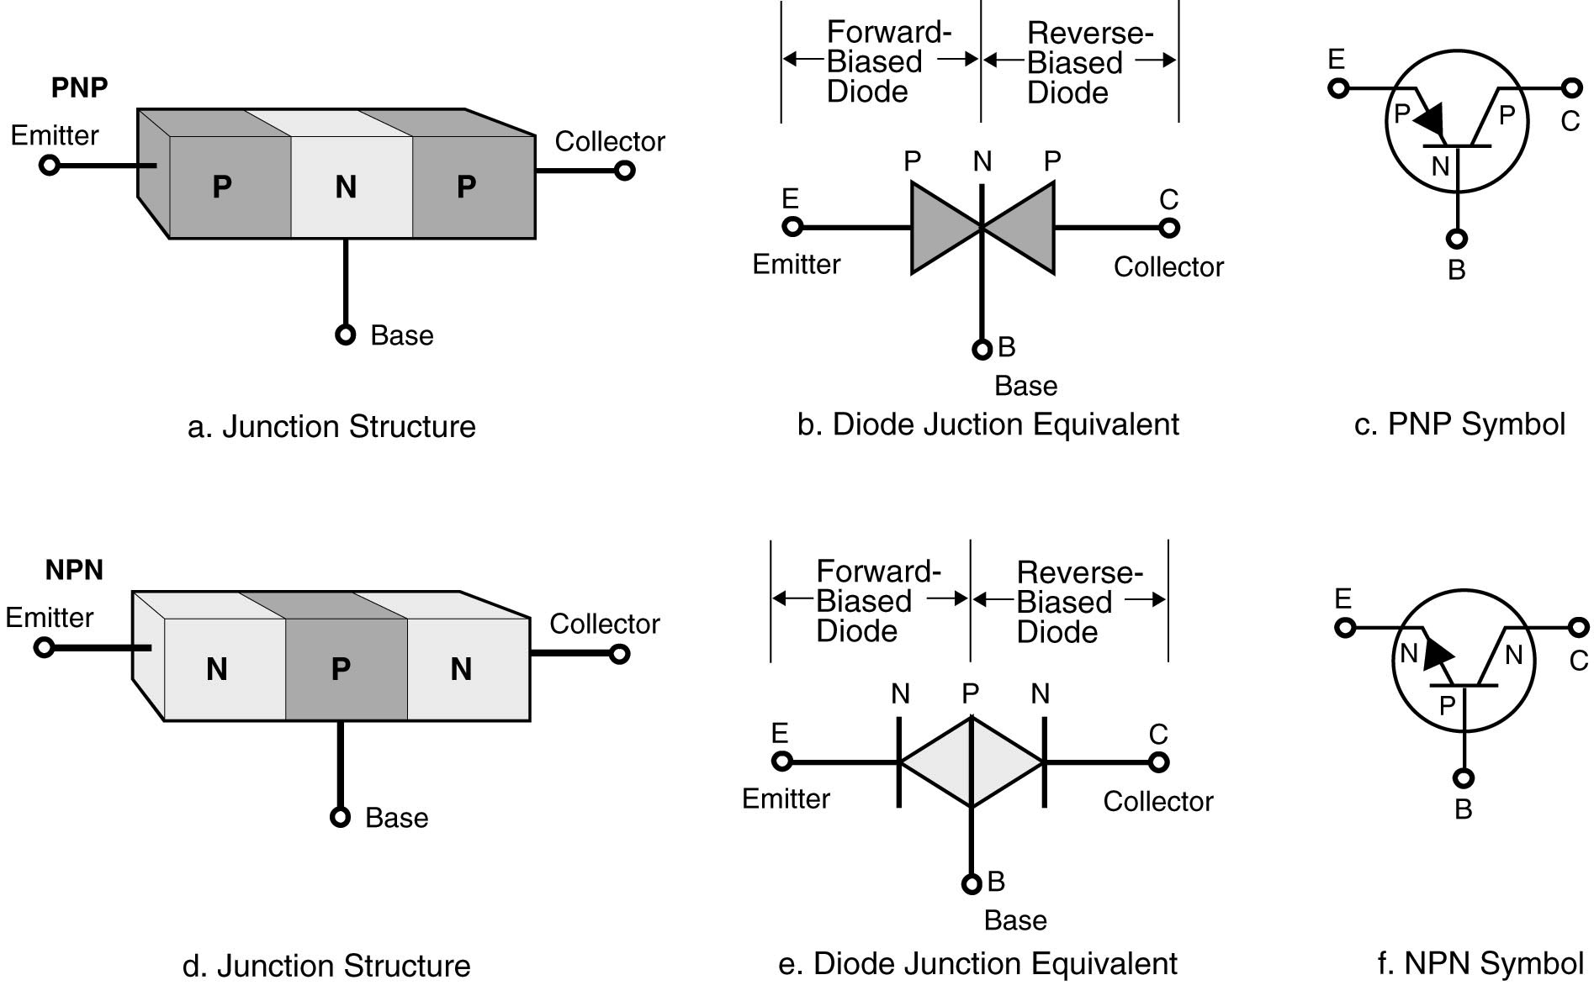
Amateur Radio Extra Class
Components in Your New Rig
Bipolar Transistor Basics --- PNP and NPN

Slide 6
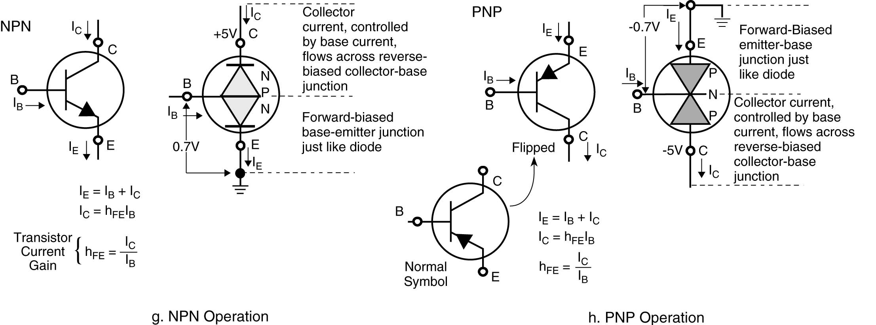
Amateur Radio Extra Class
Components in Your New Rig
Bipolar Transistor Basics --- PNP and NPN

Slide 7
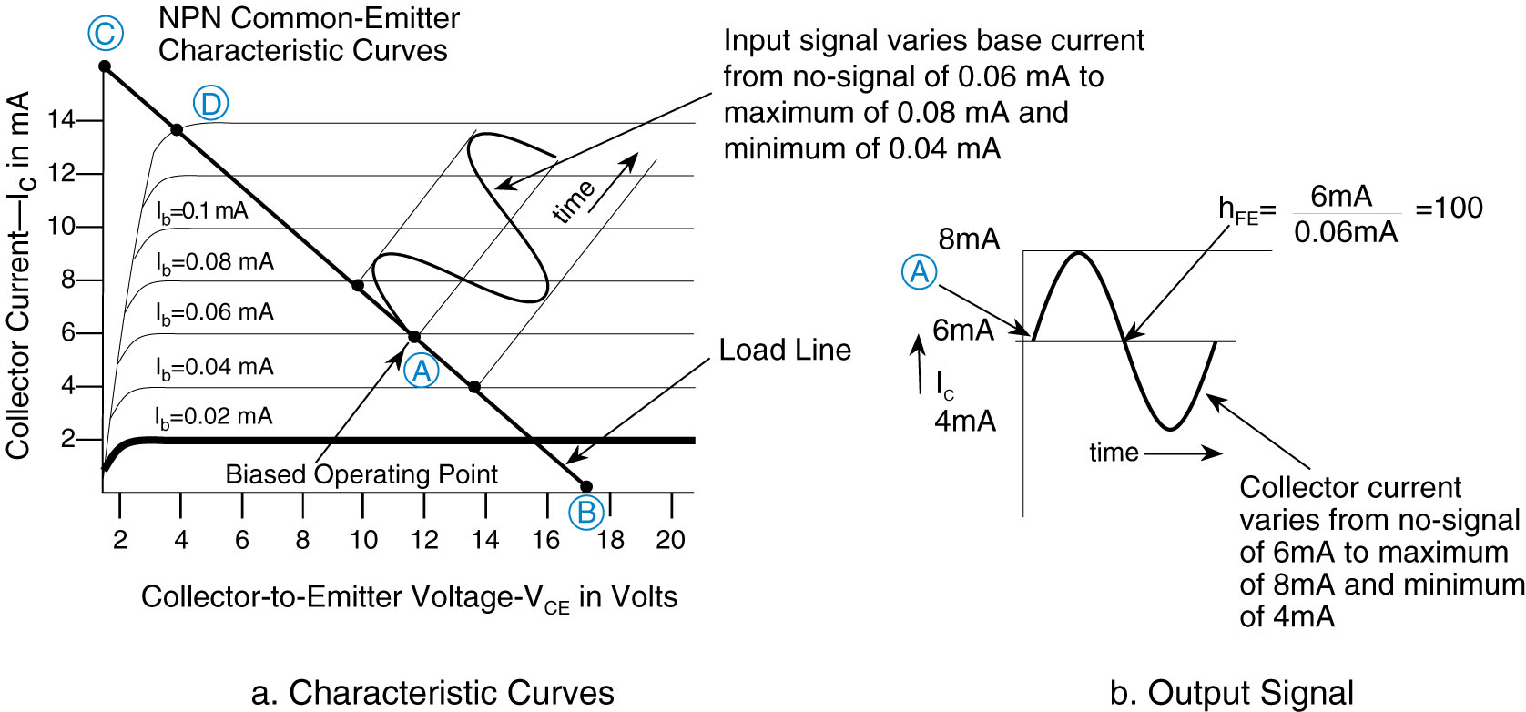
Amateur Radio Extra Class
Components in Your New Rig
E6D05… The alpha of a bipolar junction transistor refers to the change of collector current with respect to emitter current.
E6D06… The beta of a bipolar junction transistor refers to the change in collector current with respect to base current.

Slide 8
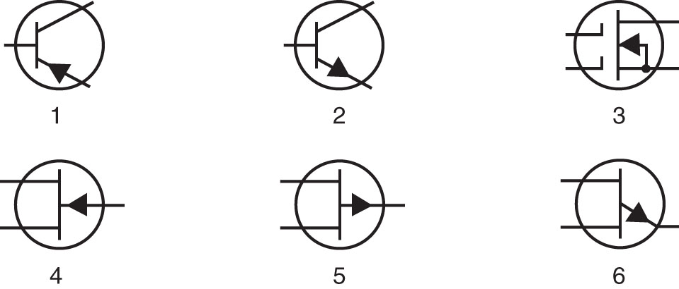
Amateur Radio Extra Class
Components in Your New Rig
E6A07… In Figure E6-1, the schematic symbol for a PNP transistor is number 1.
E4A10… A useful test for a functioning NPN transistor in an active circuit where the transistor should be biased "on" is to measure base-to-emitter voltage with a voltmeter; it should be approximately 0.6 to 0.7 volts.
Figure E6-1
+0.7 V

Slide 9
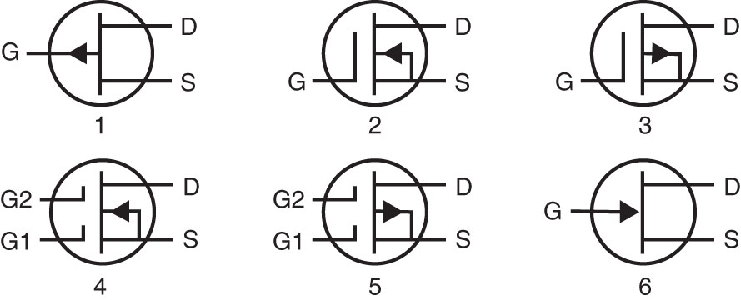
Amateur Radio Extra Class
Components in Your New Rig
E6A08… Alpha cutoff frequency indicates the frequency at which a transistor grounded base current gain has decreased to 0.7 of the gain obtainable at 1 kHz.
E6A09… A depletion-mode FET is a FET that exhibits a current flow between source and drain when no gate voltage is applied.
E6A10… In Figure E6-2, the schematic symbol for an N-channel dual-gate MOSFET is number 4.
Figure E6-2

Slide 10
Amateur Radio Extra Class
Components in Your New Rig
E6A11… In Figure E6-2, the schematic symbol for a P-channel junction FET is number 1.
E6A12… Many MOSFET devices have built-in gate-protective Zener diodes to reduce the chance of the gate insulation being punctured by static discharges or excessive voltages.
E6A13… The initials CMOS stand for Complementary metal-oxide semiconductor.
Figure E6-2

Slide 11
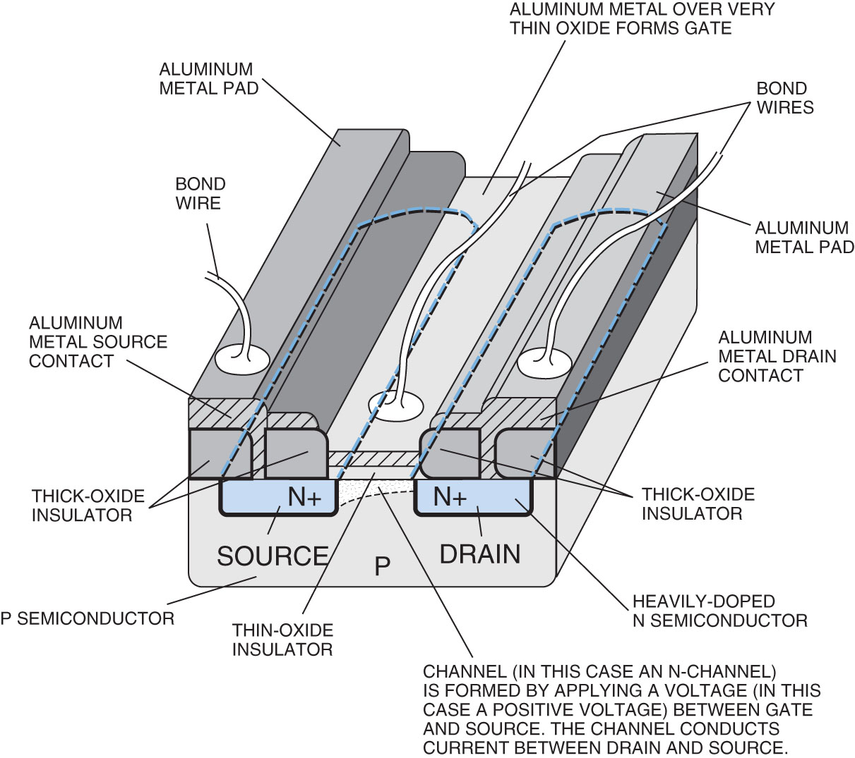
Amateur Radio Extra Class
Components in Your New Rig
E6A14… The DC input impedance at the gate of a field-effect transistor is high. The DC input impedance of the bipolar transistor is low.
Pictorial of FET construction (N-Channel Enhancement)

Slide 12
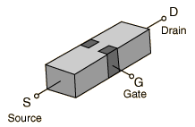
Amateur Radio Extra Class
Components in Your New Rig
E6A15… Silicon and germanium are widely used in semiconductor devices and exhibit both metallic and nonmetallic characteristics.
E6A17… Free electrons are the majority charge carriers in N-type semiconductor material.
E6A16… P-type semiconductor material contains fewer free electrons than pure germanium or silicon crystals.
E6A18… The names of the three terminals of a field-effect transistor are gate, drain, and source.
The FET has some advantages relative to the bipolar transistor. Field-effect transistors are preferred for weak-signal work, for example in wireless communications and broadcast receivers. They are also preferred in circuits and systems requiring high input impedance.
Field-effect transistors exist in two major classifications. These are known as the junction FET (JFET) and the metal-oxide- semiconductor FET (MOSFET).

Slide 13
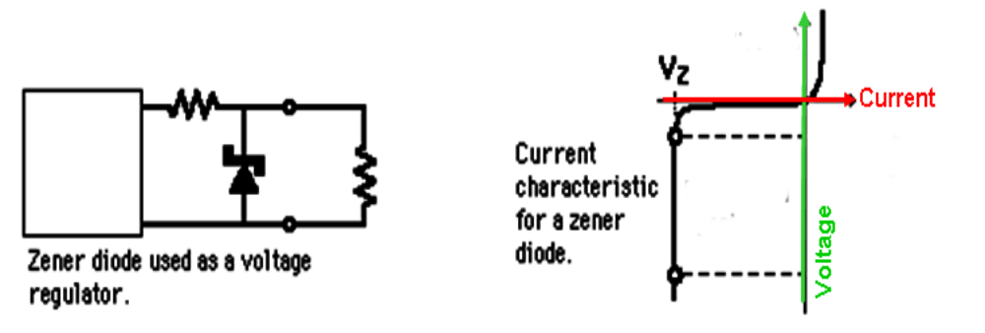
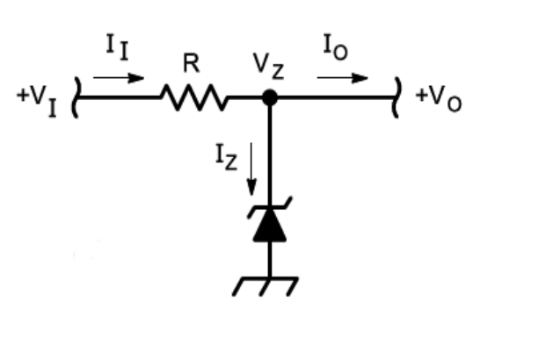
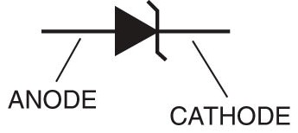
Amateur Radio Extra Class
Components in Your New Rig
E6B01… The principal characteristic of a Zener diode is a constant voltage under conditions of varying current.
Once the Zener voltage is reached increasing V_{I} will not cause V_{O} to increase only the current will increase creating a larger voltage drop across R, up to the maximum current rating for the zener diode.
Schematic symbol of a Zener diode. Since a diode only passes current in one direction, look for the one-way arrow plus a “Z” to indicate it is a Zener diode.
Zener diode

Slide 14
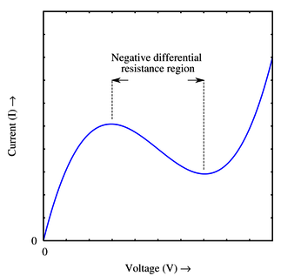
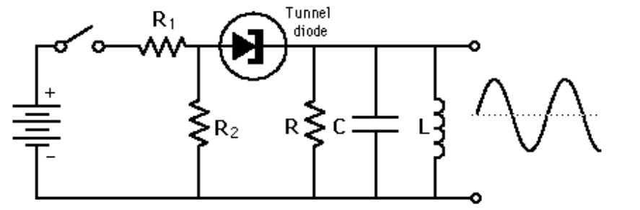
Amateur Radio Extra Class
Components in Your New Rig
E6B02… The principal characteristic of a tunnel diode is a negative resistance region.
E6B04… A Tunnel diode is capable of both amplification and oscillation.
E6B03… An important characteristic of a Schottky Barrier diode as compared to an ordinary silicon diode when used as a power supply rectifier is less forward voltage drop.

Slide 15
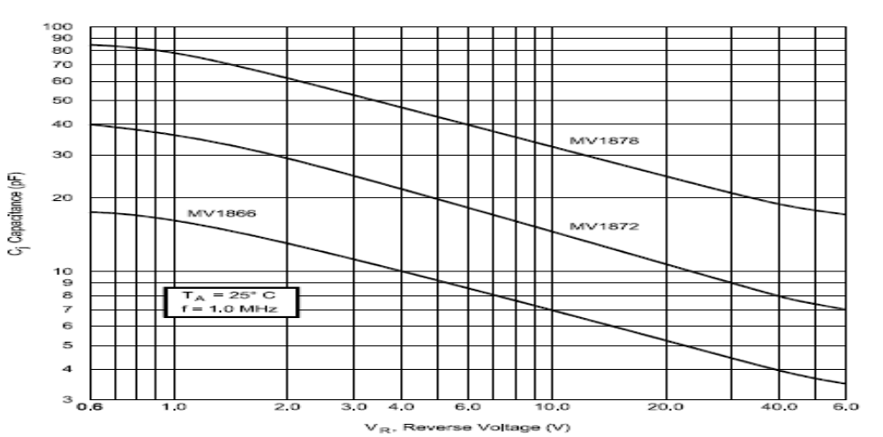
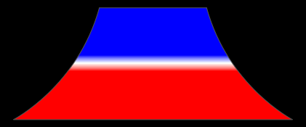
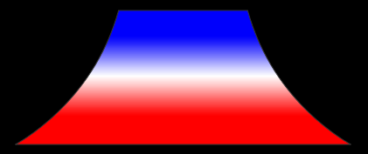
Amateur Radio Extra Class
Components in Your New Rig
Amateur Radio Extra Class
E6B05… A Varactor diode is a type of semiconductor device that varies its internal capacitance as the voltage applied to its terminals varies.
Lower bias voltage, narrower depletion zone, higher capacitance
Varactor diode
Looks like schematic symbol for capacitor with a triangle.
Higher bias voltage, wider depletion zone, lower capacitance

Slide 16
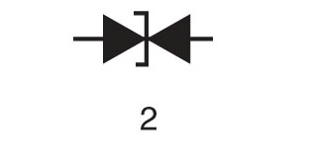
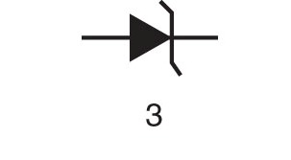
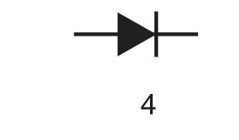
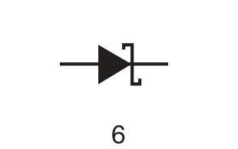
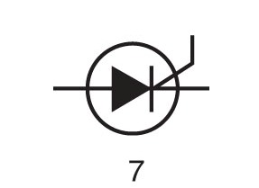
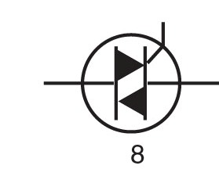
Amateur Radio Extra Class
Components in Your New Rig
E6B06… In Figure E6-3, the schematic symbol for a varactor diode is number 1.
E6B11… Number 5 in Figure E6-3 is the schematic symbol for a light-emitting diode.
1
5
Figure E6-3

Slide 17
Amateur Radio Extra Class
Components in Your New Rig
E6B07… A common use of a hot-carrier diode is as a VHF / UHF mixer or detector.
E6B08… Junction temperature limits the maximum forward current rating in a junction diode.
E6B09… Metal-semiconductor junction describes a type of semiconductor diode.
E6B10… A common use for point contact diodes is as an RF detector.
E6B12… Junction diodes are rated for maximum forward current and PIV (Peak Inverse Voltage).

Slide 18
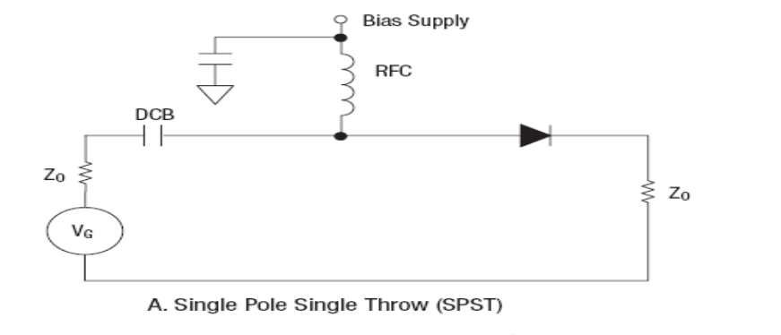
Amateur Radio Extra Class
Components in Your New Rig
E6B13… A common use for PIN diodes is as an RF switch.
E6B14… Forward bias is required for an LED to produce luminescence.
E6C01… 5 volts is the recommended power supply voltage for TTL series integrated circuits.
E6C02… The inputs of a TTL device assume a logic-high state if they are left open.
E6C03… The input voltage for a logic "high" in a TTL device operating with a positive 5-volt power supply is 2.0 to 5.5 volts.

Slide 19
Amateur Radio Extra Class
Components in Your New Rig
E6C04… The input voltage for a logic "low" in a TTL device operating with a positive 5-volt power-supply is 0.0 to 0.8 volts.
E6C05… The advantage of CMOS logic devices over TTL devices is lower power consumption.
E6C06… Because the input switching threshold is about one-half the power supply voltage, CMOS digital integrated circuits have high immunity to noise on the input signal or power supply.
E6E07… The characteristic impedance of circuits in which almost all MMICs are designed to work is 50 ohms.
E6E08… The typical noise figure of a monolithic microwave integrated circuit (MMIC) amplifier is approximately 3.5 to 6 dB.

Slide 20
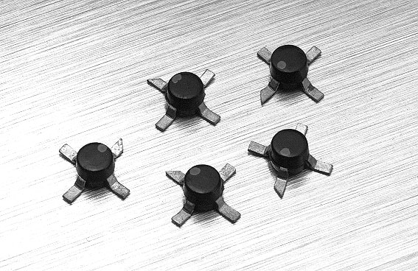
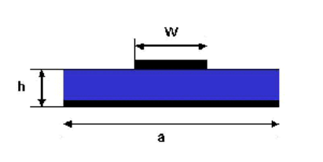
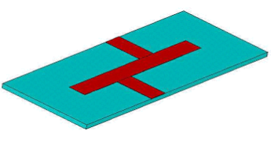
Amateur Radio Extra Class
Components in Your New Rig
E6E09… An amplifier device that consists of a small pill-type package with an input lead, an output lead and 2 ground leads is a monolithic microwave integrated circuit (MMIC).
E6E10… Typically a microstrip construction technique is used when building an amplifier for the microwave bands containing a monolithic microwave integrated circuit (MMIC).

Slide 21
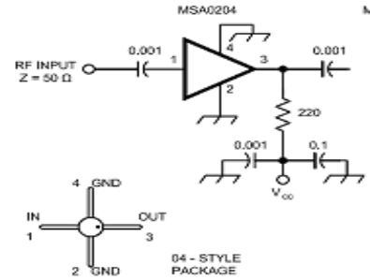
Amateur Radio Extra Class
Components in Your New Rig
E6E11… The operating bias voltage normally supplied to the most common type of monolithic microwave integrated circuit (MMIC) is through a resistor and/or RF choke connected to the amplifier output lead.
E6E12… Monolithic microwave integrated circuits (MMIC) amplifiers typically require a supply voltage of 12 volts DC.
E6E13… Plastic packages are the most common package for inexpensive monolithic microwave integrated circuit (MMIC) amplifiers.

Slide 22

Element 4 Extra Class
Question Pool
Components in Your New Rig
Valid July 1, 2008
Through
June 30, 2012

Slide 23
E6A01 In what application is gallium arsenide used as a semiconductor material in preference to germanium or silicon?
In high-current rectifier circuits
In high-power audio circuits
At microwave frequencies
At very low frequency RF circuits

Slide 24
E6A02 What type of semiconductor material contains more free electrons than pure germanium or silicon crystals?
N-type
P-type
Bipolar
Insulated gate

Slide 25
E6A03 What are the majority charge carriers in P-type semiconductor material?
Free neutrons
Free protons
Holes
Free electrons

Slide 26
E6A04 What is the name given to an impurity atom that adds holes to a semiconductor crystal structure?
Insulator impurity
N-type impurity
Acceptor impurity
Donor impurity

Slide 27
E6A05 What is the alpha of a bipolar junction transistor?
The change of collector current with respect to base current
The change of base current with respect to collector current
The change of collector current with respect to emitter current
The change of collector current with respect to gate current

Slide 28
E6A06 What is meant by the beta of a bipolar junction transistor?
The frequency at which the current gain is reduced to 1
The change in collector current with respect to base current
The breakdown voltage of the base to collector junction
The switching speed of the transistor

Slide 29
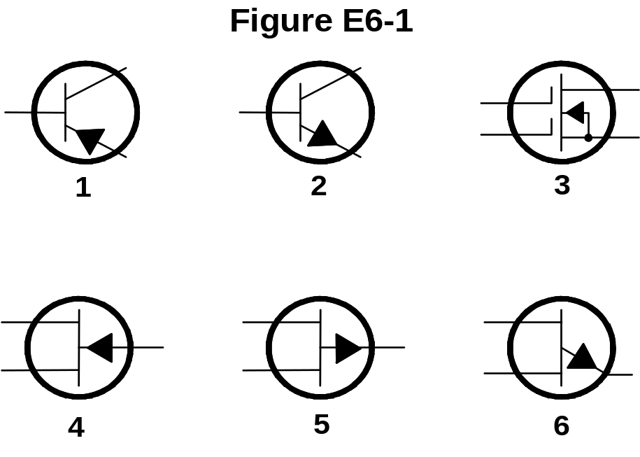
E6A07 In Figure E6-1, what is the schematic symbol for a PNP transistor?
1
2
4
5

Slide 30
E4A10 Which of the following is a useful test for a functioning NPN transistor in an active circuit where the transistor should be biased "on" ?
Measure base-to-emitter resistance with an ohmmeter; it should be approximately 6 to 7 ohms
Measure base-to-emitter resistance with an ohmmeter; it should be approximately 0.6 to 0.7 ohms
Measure base-to-emitter voltage with a voltmeter; it should be approximately 6 to 7 volts
Measure base-to-emitter voltage with a voltmeter; it should be approximately 0.6 to 0.7 volts

Slide 31
E6A08 What term indicates the frequency at which a transistor grounded base current gain has decreased to 0.7 of the gain obtainable at 1 kHz?
Corner frequency
Alpha rejection frequency
Beta cutoff frequency
Alpha cutoff frequency

Slide 32
E6A09 What is a depletion-mode FET?
An FET that exhibits a current flow between source and drain when no gate voltage is applied
An FET that has no current flow between source and drain when no gate voltage is applied
An FET without a channel so no current flows with zero gate voltage
An FET without a channel so maximum gate current flows

Slide 33
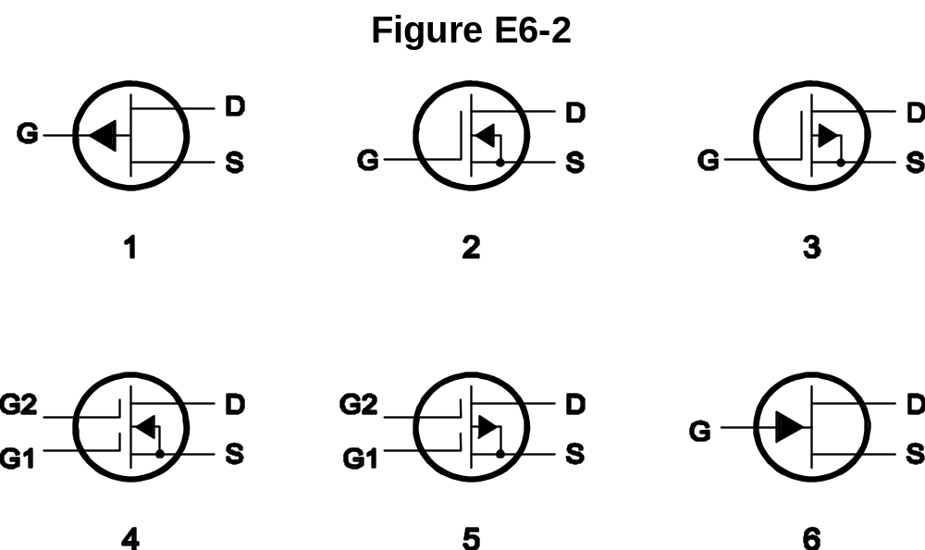
E6A10 In Figure E6-2, what is the schematic symbol for an N-channel dual-gate MOSFET?
2
4
5
6

Slide 34
E6A11 In Figure E6-2, what is the schematic symbol for a P-channel junction FET?
1
2
3
6

Slide 35
E6A12 Why do many MOSFET devices have built-in gate-protective Zener diodes?
To provide a voltage reference for the correct amount of reverse-bias gate voltage
To protect the substrate from excessive voltages
To keep the gate voltage within specifications and prevent the device from overheating
To reduce the chance of the gate insulation being punctured by static discharges or excessive voltages

Slide 36
E6A13 What do the initials CMOS stand for?
Common mode oscillating system
Complementary mica-oxide silicon
Complementary metal-oxide semiconductor
Complementary metal-oxide substrate

Slide 37
E6A14 How does DC input impedance at the gate of a field-effect transistor compare with the DC input impedance of a bipolar transistor?
They cannot be compared without first knowing the supply voltage
An FET has low input impedance; a bipolar transistor has high input impedance
An FET has high input impedance; a bipolar transistor has low input impedance
The input impedance of FETs and bipolar transistors is the same

Slide 38
E6A15 What two elements widely used in semiconductor devices exhibit both metallic and nonmetallic characteristics?
Silicon and gold
Silicon and germanium
Galena and germanium
Galena and bismuth

Slide 39
E6A17 What are the majority charge carriers in N-type semiconductor material?
Holes
Free electrons
Free protons
Free neutrons

Slide 40
E6A16 What type of semiconductor material contains fewer free electrons than pure germanium or silicon crystals?
N-type
P-type
Superconductor-type
Bipolar-type

Slide 41
E6A18 What are the names of the three terminals of a field-effect transistor?
Gate 1, gate 2, drain
Emitter, base, collector
Emitter, base 1, base 2
Gate, drain, source

Slide 42
E6B01 What is the principal characteristic of a Zener diode?
A constant current under conditions of varying voltage
A constant voltage under conditions of varying current
A negative resistance region
An internal capacitance that varies with the applied voltage

Slide 43
E6B02 What is the principal characteristic of a tunnel diode?
A high forward resistance
A very high PIV
A negative resistance region
A high forward current rating

Slide 44
E6B03 What is an important characteristic of a Schottky Barrier diode as compared to an ordinary silicon diode when used as a power supply rectifier?
Much higher reverse voltage breakdown
Controlled reverse avalanche voltage
Enhanced carrier retention time
Less forward voltage drop

Slide 45
E6B04 What special type of diode is capable of both amplification and oscillation?
Point contact
Zener
Tunnel
Junction

Slide 46
E6B05 What type of semiconductor device varies its internal capacitance as the voltage applied to its terminals varies?
Tunnel diode
Varactor diode
Silicon-controlled rectifier
Zener diode

Slide 47
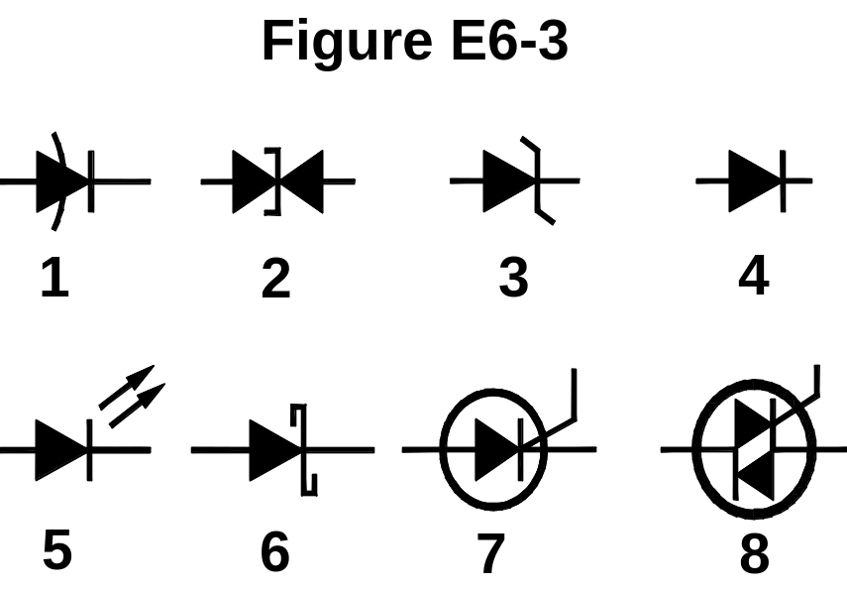
E6B06 In Figure E6-3, what is the schematic symbol for a varactor diode?
8
6
2
1

Slide 48
E6B11 In Figure E6-3, what is the schematic symbol for a light-emitting diode?
1
5
6
7

Slide 49
E6B07 What is a common use of a hot-carrier diode?
As balanced mixers in FM generation
As a variable capacitance in an automatic frequency control circuit
As a constant voltage reference in a power supply
As a VHF / UHF mixer or detector

Slide 50
E6B08 What limits the maximum forward current rating in a junction diode?
Peak inverse voltage
Junction temperature
Forward voltage
Back EMF

Slide 51
E6B09 Which of the following describes a type of semiconductor diode?
Metal-semiconductor junction
Electrolytic rectifier
CMOS-field effect
Thermionic emission diode

Slide 52
E6B10 What is a common use for point contact diodes?
As a constant current source
As a constant voltage source
As an RF detector
As a high voltage rectifier

Slide 53
E6B12 How are junction diodes rated?
Maximum forward current and capacitance
Maximum reverse current and PIV
Maximum reverse current and capacitance
Maximum forward current and PIV

Slide 54
E6B13 What is one common use for PIN diodes?
As a constant current source
As a constant voltage source
As an RF switch
As a high voltage rectifier

Slide 55
E6B14 What type of bias is required for an LED to produce luminescence?
Reverse bias
Forward bias
Zero bias
Inductive bias

Slide 56
E6C01 What is the recommended power supply voltage for TTL series integrated circuits?
12 volts
1.5 volts
5 volts
13.6 volts

Slide 57
E6C02 What logic state do the inputs of a TTL device assume if they are left open?
A logic-high state
A logic-low state
The device becomes randomized and will not provide consistent high or low-logic states
Open inputs on a TTL device are ignored

Slide 58
E6C03 What level of input voltage is a logic "high" in a TTL device operating with a positive 5-volt power supply?
2.0 to 5.5 volts
1.5 to 3.0 volts
1.0 to 1.5 volts
-5.0 to -2.0 volts

Slide 59
E6C04 What level of input voltage is a logic "low" in a TTL device operating with a positive 5-volt power-supply?
-2.0 to -5.5 volts
2.0 to 5.5 volts
0.0 to 0.8 volts
-0.8 to 0.4 volts

Slide 60
E6C05 Which of the following is an advantage of CMOS logic devices over TTL devices?
Differential output capability
Lower distortion
Immune to damage from static discharge
Lower power consumption

Slide 61
E6C06 Why do CMOS digital integrated circuits have high immunity to noise on the input signal or power supply?
Larger bypass capacitors are used in CMOS circuit design
The input switching threshold is about two times the power supply voltage
The input switching threshold is about one-half the power supply voltage
Input signals are stronger

Slide 62
E6E07 What is the characteristic impedance of circuits in which almost all MMICs are designed to work?
50 ohms
300 ohms
450 ohms
10 ohms

Slide 63
E6E08 What is the typical noise figure of a monolithic microwave integrated circuit (MMIC) amplifier?
Less than 1 dB
Approximately 3.5 to 6 dB
Approximately 8 to 10 dB
More than 20 dB

Slide 64
E6E09 What type of amplifier device consists of a small pill-type package with an input lead, an output lead and 2 ground leads?
A junction field-effect transistor (JFET)
An operational amplifier integrated circuit (OAIC)
An indium arsenide integrated circuit (IAIC)
A monolithic microwave integrated circuit (MMIC)

Slide 65
E6E10 What typical construction technique is used when building an amplifier for the microwave bands containing a monolithic microwave integrated circuit (MMIC)?
Ground-plane "ugly" construction
Microstrip construction
Point-to-point construction
Wave-soldering construction

Slide 66
E6E11 How is the operating bias voltage normally supplied to the most common type of monolithic microwave integrated circuit (MMIC)?
Through a resistor and/or RF choke connected to the amplifier output lead
MMICs require no operating bias
Through a capacitor and RF choke connected to the amplifier input lead
Directly to the bias-voltage (VCC IN) lead

Slide 67
E6E12 What supply voltage do monolithic microwave integrated circuits (MMIC) amplifiers typically require?
1 volt DC
12 volts DC
20 volts DC
120 volts DC

Slide 68
E6E13 What is the most common package for inexpensive monolithic microwave integrated circuit (MMIC) amplifiers?
Beryllium oxide packages
Glass packages
Plastic packages
Ceramic packages

